Slide 1
Peng Yu & Sun Yuan
Artist Presentation, Zhifei (Maggie) Li

Slide 2
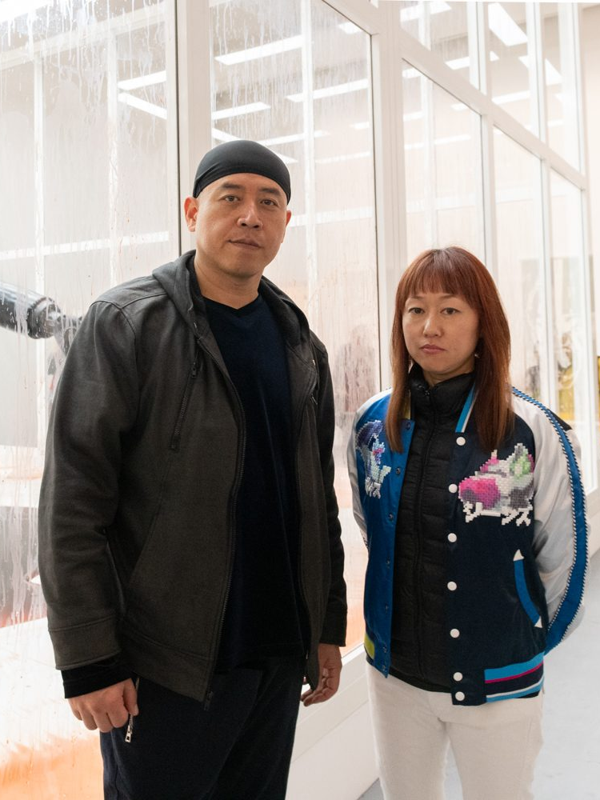
1. Introduction
彭禹 (Peng Yu) and 孙原 (Sun Yuan)
Peng born in Heilongjiang in 1974, and Sun born in Beijing in 1972
Married, collaborating since 1990s
Being referred to as “one person”?

Slide 3
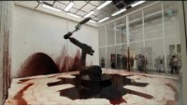
2.1. 难自禁(Can’t Help Myself), 2016

Slide 4
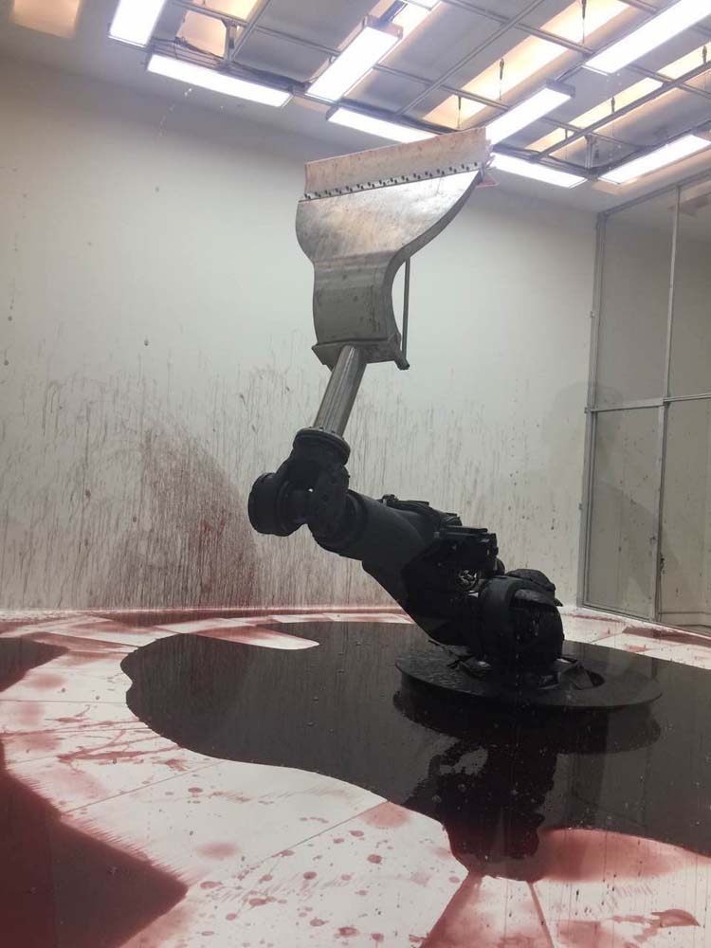
2.1. 难自禁(Can’t Help Myself), 2016
How do you feel like after watching the clip? Horrified? Amazed? Feeling nothing?
What do you think the machine is doing? Is it crying? Is it struggling? Is it…dancing?

Slide 5
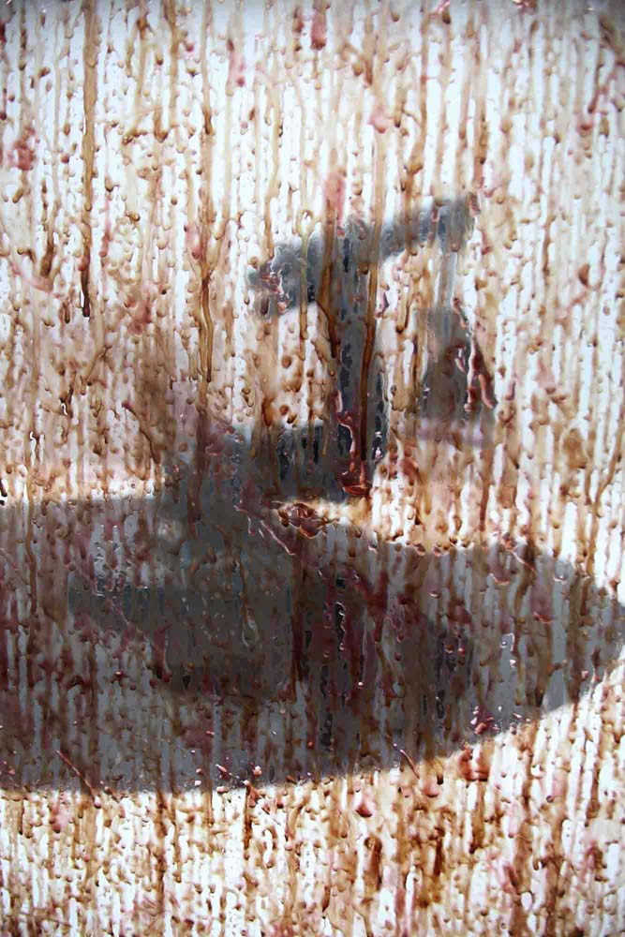
2.1. 难自禁(Can’t Help Myself), 2016
Various interpretations: migration, sovereignty, surveillance, use of technology…
Material: industrial robot, stainless steel and rubber, cellulose ether in colored water, lighting grid with visual-recognition sensors, acrylic wall with aluminum frame

Slide 6
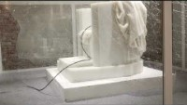
2.2. 亲爱的(Dear), 2015

Slide 7
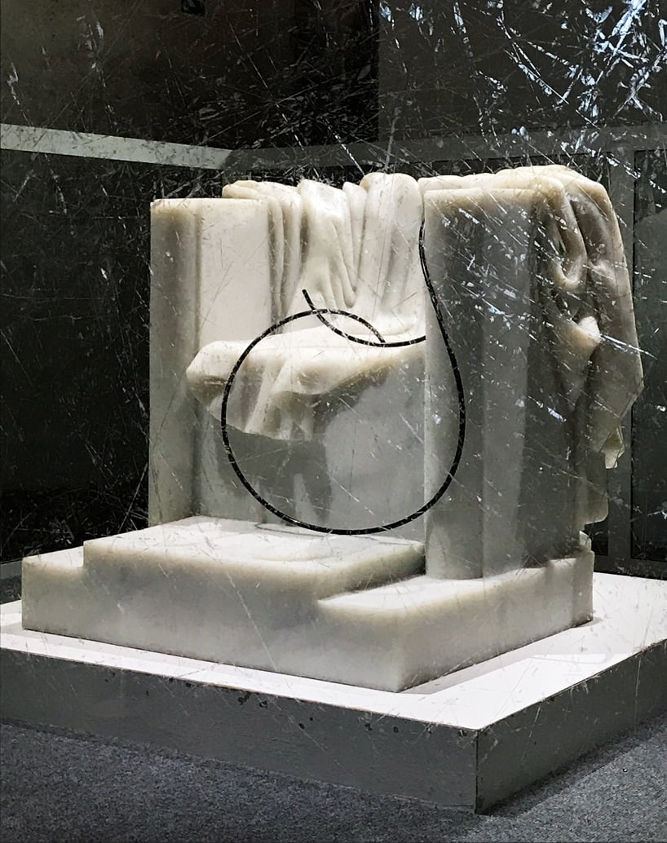
2.2. 亲爱的(Dear), 2015
Material (unofficial): Imperial Roman throne sculpture, pipe, and the glass
Control and resistance in close relationship; only the damages on the glass can manifest the existence of past struggles

Slide 8
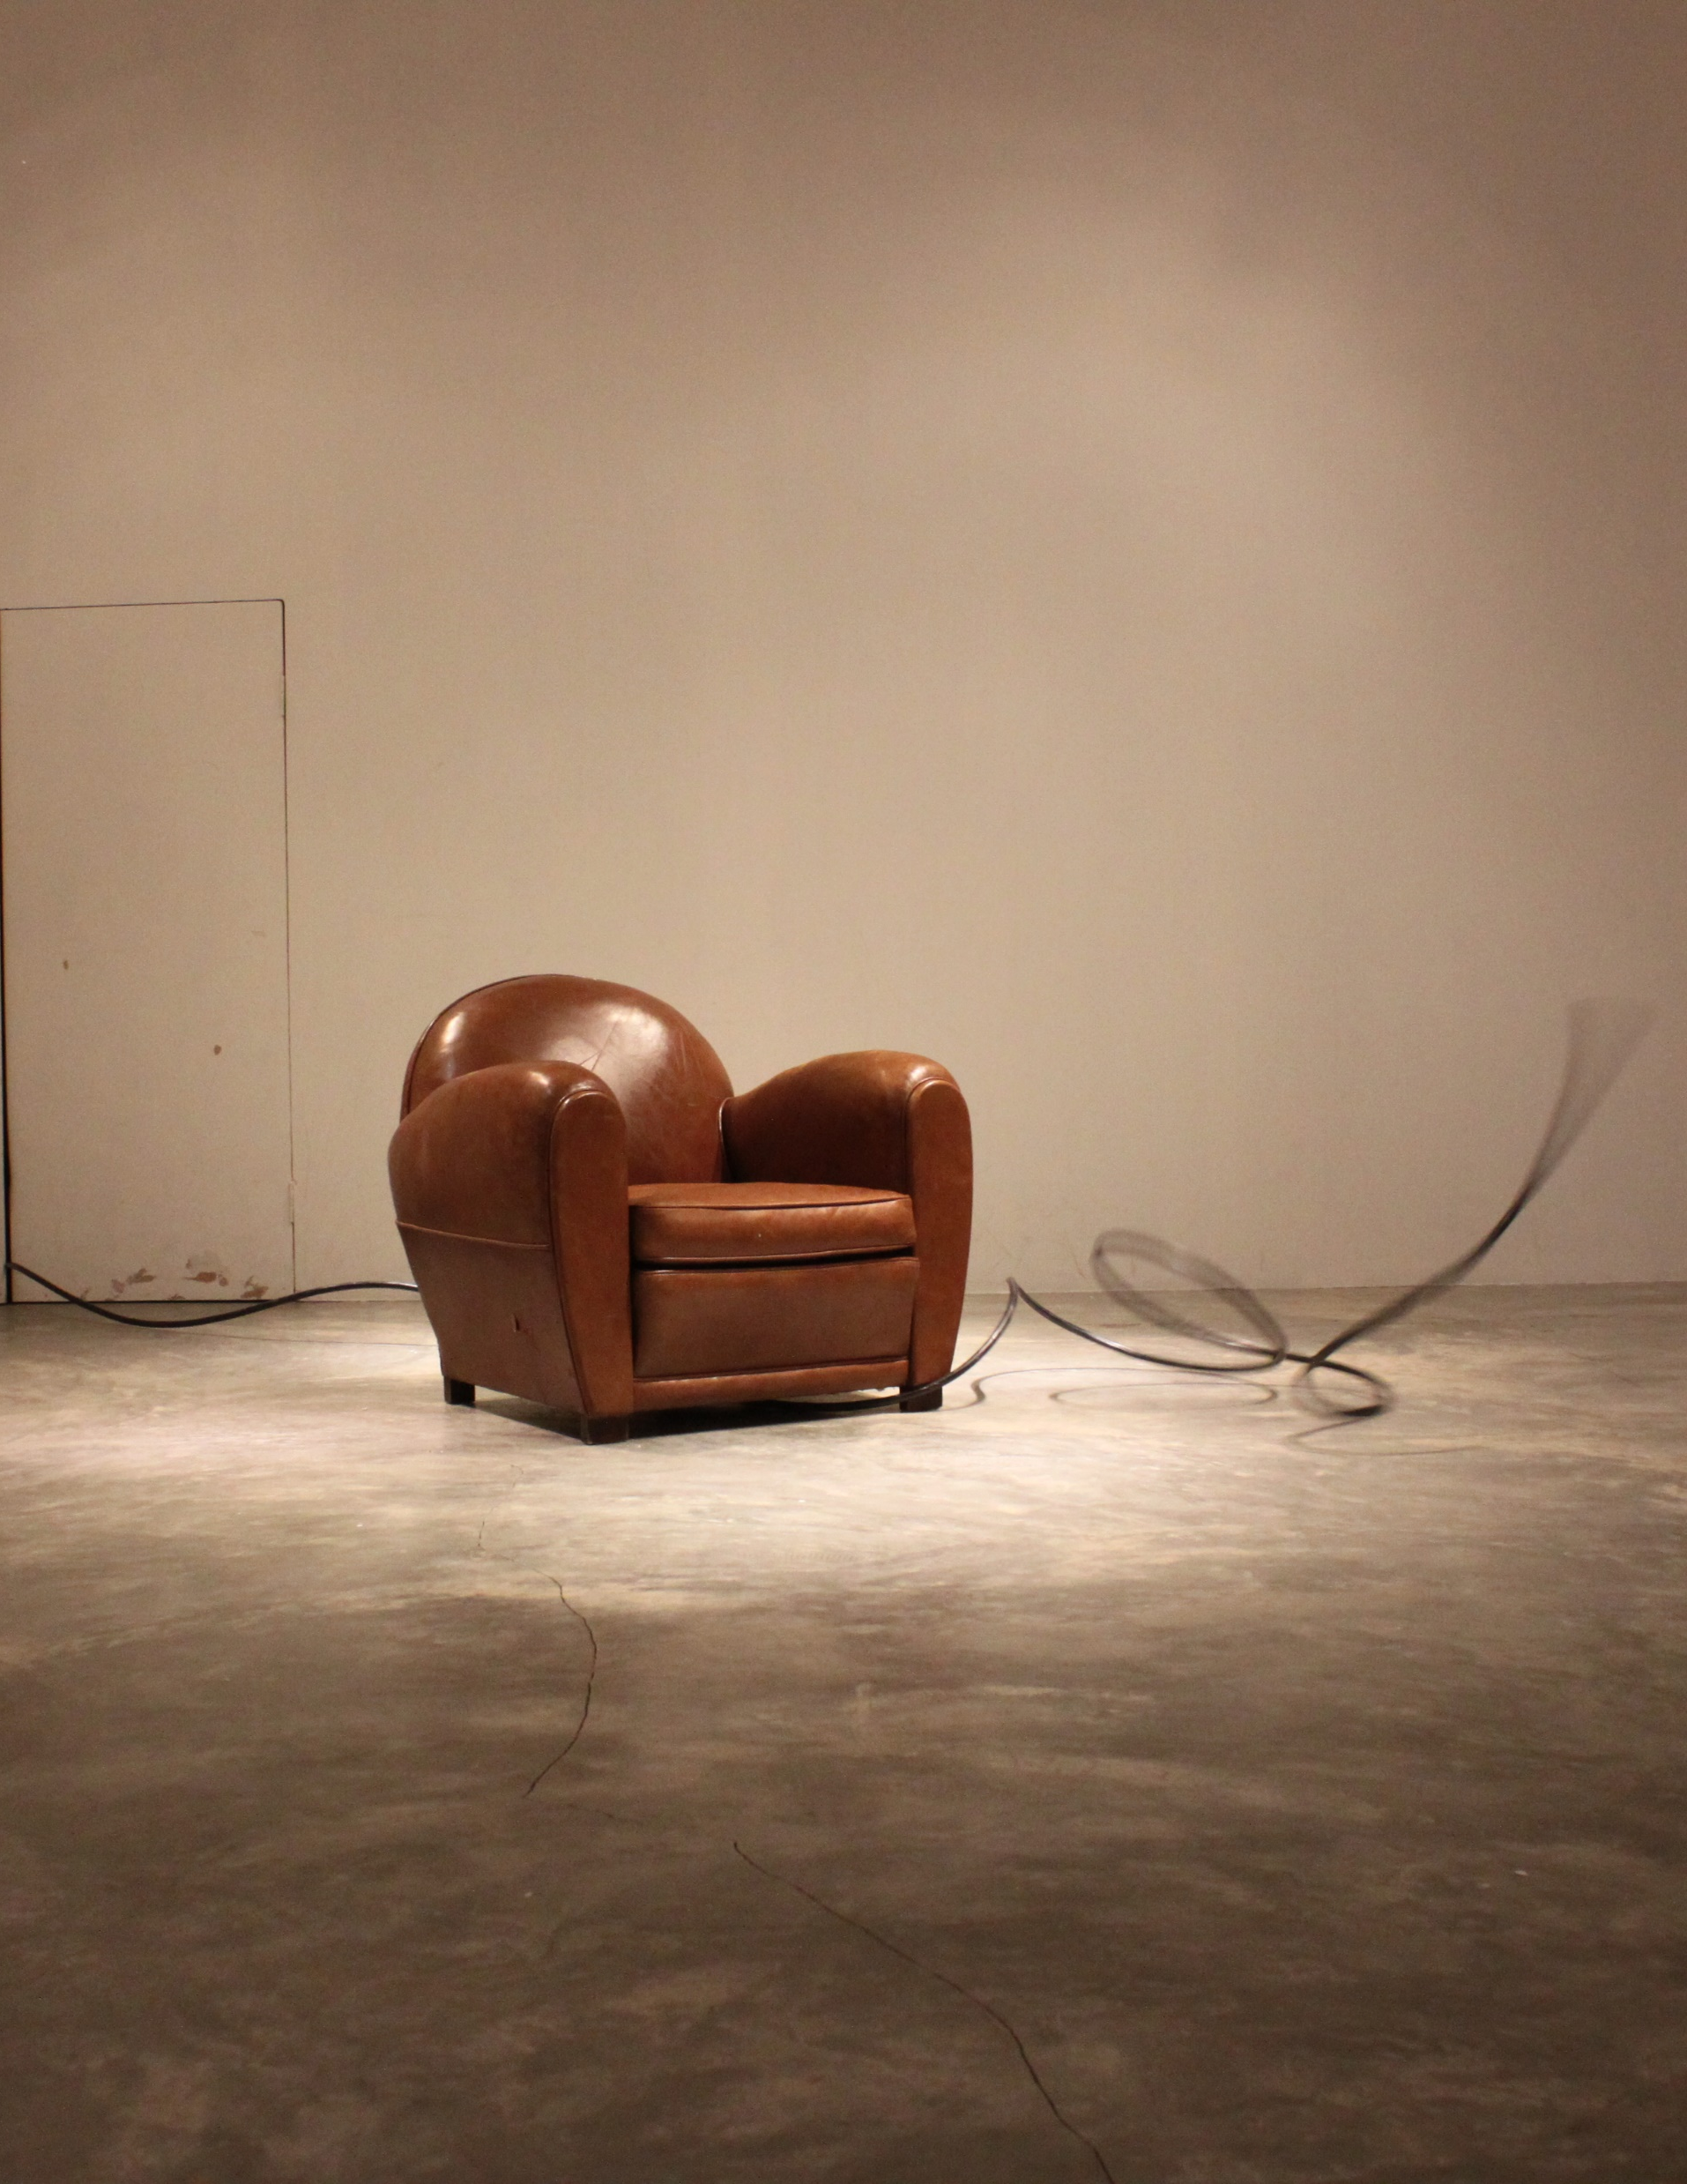
2.2. 亲爱的(Dear), 2015
Another form of Dear on their official website with the absence of glass
Material: air pump, air tank, hose, sofa
Which one do you think is more impactive?

Slide 9
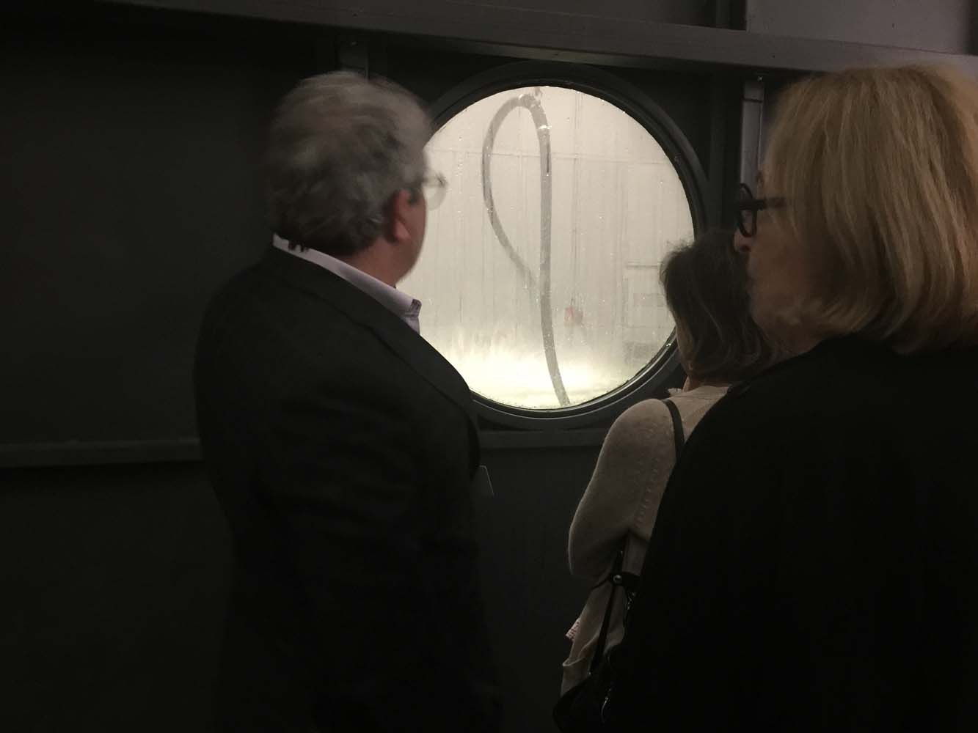
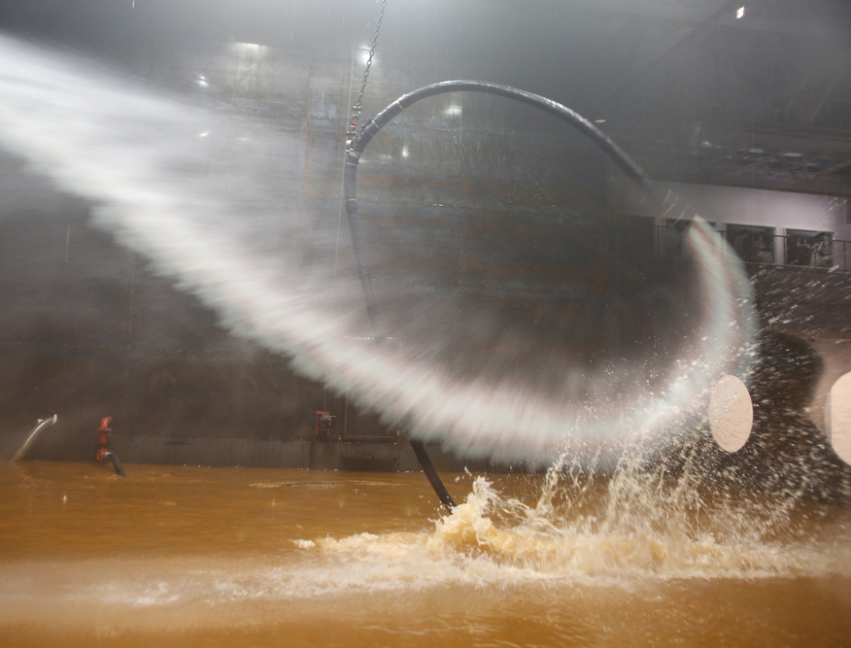
2.3. 自由(Freedom), 2009
Material: metal plate, high-pressure hydraulic pump, fire hose, hydrant, electronic control system
Struggles to break free from the ground yet it can’t
What are the windows for?
–voyeurism

Slide 10
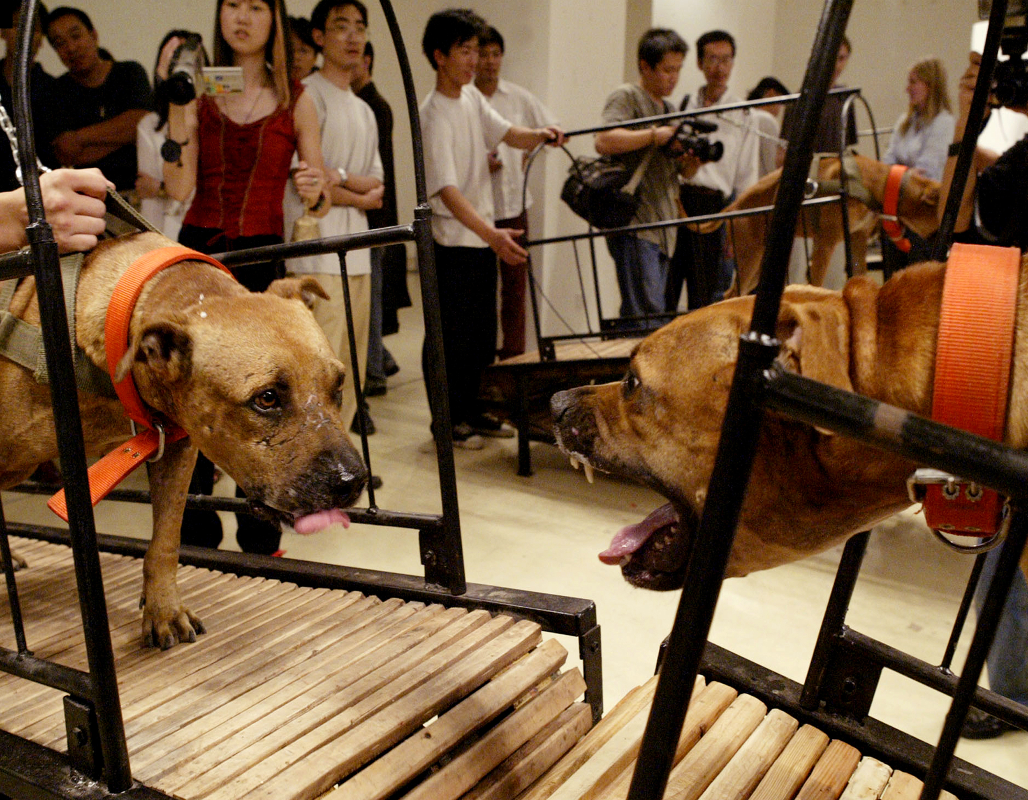
2.4. 犬勿近(Dogs that Cannot Touch Each Other), 2009
Material: 8 Bull Terriers, 8 running machines without drive
Control and violence
Social dispute: animal maltreatment?

Slide 11
3. Summary of Style and Philosophy
Installation art
Confront the viewers with uncomfortable, unsettling situations, evoke strong emotional reaction; viewers set to be standers-by; multiple interpretations allowed
Challenge conventional norms, provoke discussions surrounding power and control

Slide 12
4. Reference
https://www.diggitmagazine.com/papers/can-t-help-myself-how-relatable-robot-offers-critical-reflection-modern-society
https://www.galleriacontinua.com/artists/sun-yuan-peng-yu-73
https://www.designboom.com/art/sun-yuan-peng-yu-dear-venice-art-biennale-05-09-2019/
https://artmap.com/continuasg/exhibition/sun-yuan-peng-yu-2011

